Slide 1

Automotive Technology: A Systems Approach, 8e
Chapter 27: Ignition System Diagnosis and Service
Rob Thompson and Jack Erjavec, Automotive Technology: A Systems Approach, 8th Edition. © 2025 Cengage. All Rights Reserved. May not be scanned, copied or duplicated, or posted to a publicly accessible website, in whole or in part.

Slide 2
Chapter Objectives (1 of 2)
27.01 Determine the causes of engine misfires.
27.02 Perform a visual inspection of ignition system components, primary wiring, and secondary wiring to locate obvious trouble areas.
27.03 Perform a no-start diagnosis and determine the cause of the condition.
27.04 Perform a visual inspection of ignition system components, primary wiring, and secondary wiring to locate obvious trouble areas.

Slide 3
Chapter Objectives (2 of 2)
27.05 Diagnose ignition system concerns using a lab scope.
27.06 Test individual ignition components using test equipment such as a voltmeter, ohmmeter, and test light.
27.07 Describe the effects of incorrect ignition timing.
27.08 Test the components of the primary and secondary ignition circuits.
27.09 Service and install spark plugs.

Slide 4
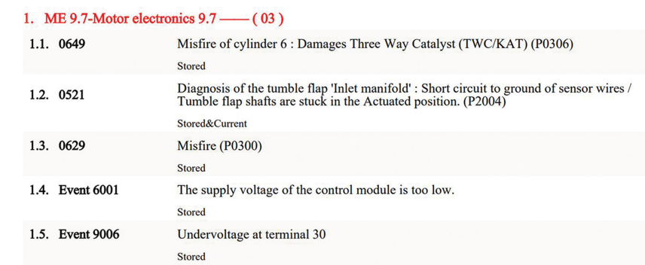
Misfires (1 of 2)
27.01 Determine the causes of engine misfires.
When something prevents complete combustion, the result is a misfire or incomplete combustion.
Misfires can cause lack of power, poor gas mileage, excessive exhaust emissions, and a rough running engine.
Misfires are not always caused by the ignition system; other systems also can cause them.
Ignition misfires can be caused by a fouled or damaged spark plug, a bad coil, problems in the primary or secondary ignition circuit, or an incorrect plug gap.

Slide 5
Misfires (2 of 2)
Abnormal Combustion
  Incomplete combustion is not the only abnormal condition engines may experience; they may also experience detonation.
  Detonation is usually caused by excessively advanced ignition timing, engine overheating, excessively lean mixtures, or the use of low-octane gasoline.
  Detonation can cause physical damage to the pistons, valves, bearings, and spark plugs.
  Preignition can cause pinging or spark knocking.
  Any hot spot within the combustion chamber can cause preignition.
  Common causes of preignition are incandescent carbon deposits in the combustion chamber, a faulty cooling system, too hot of a spark plug, poor engine lubrication, and cross firing.
  Preignition usually leads to detonation; preignition and detonation are two separate events.

Slide 6
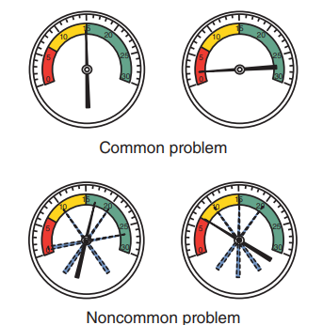
General Ignition System Diagnosis
Common vs Noncommon Problems
  In most cases, ignition problems can be divided into two types: common and noncommon.
  Common problems are those that affect all cylinders, and noncommon problems are those that affect one or more cylinders but not all.
  The best indicator of a noncommon problem is the reading on a vacuum gauge.
  If a vacuum gauge is connected to a four-cylinder engine at idle and the needle of the gauge is within the normal vacuum range for three-fourths of the time and drops one-fourth of the time, this indicates that three of the cylinders are working normally while the fourth is not.

Slide 7
Ignition System Inspection
27.02 Perform a visual inspection of ignition system components, primary wiring, and secondary wiring to locate obvious trouble areas.
Begin all diagnosis by gathering as much information as possible from the customer.
Then conduct a careful visual inspection. The system should be checked for obvious problems.
Although no-start problems and incorrect ignition timing are caused by the primary circuit, the secondary circuit can be the cause of driveability problems and should be carefully checked.
In addition to the ignition system, inspect all related electrical connectors or fuses, vacuum lines, air intake system, and cooling system.
Also check available service information that may relate to the symptoms

Slide 8
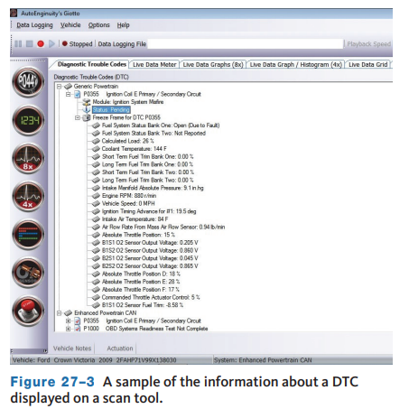
Scan Tools
Performing a system scan is now standard procedure whenever a vehicle has a performance concern.
Even if misfire diagnostic trouble codes (DTCs) are not present, do not ignore other current and history DTCs.
A vehicle may not set misfire codes (P0301–P0312) if certain other codes are present.
Within the OBD II diagnostic trouble code structure, DTCs P0300 through P0399 are specific to the ignition system and misfires
Sometimes, the PCM needs to be reprogrammed due to changes made in the strategy or calibrations after the vehicle was produced.
DTCs and scan tool data should be retrieved during the initial diagnostic routine.

Slide 9
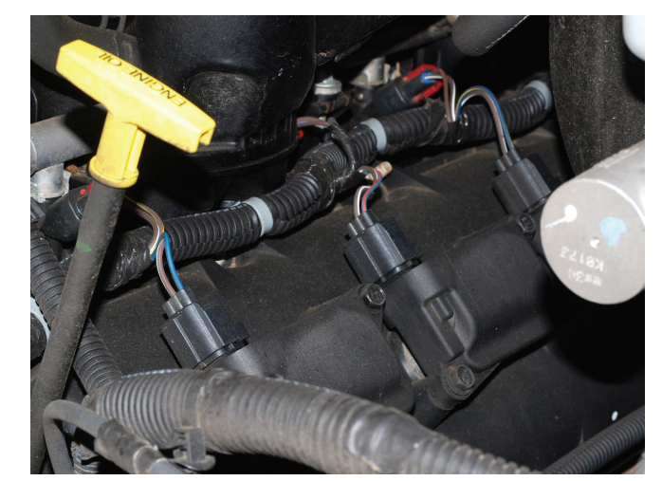
Primary Circuit
Primary ignition system wiring should be checked for tight connections.
Electronic circuits operate on very low voltage.
Voltage drops caused by corrosion or dirt can cause running problems.
Missing or broken tab locks on wire terminals are often the cause of intermittent ignition problems due to vibration or thermal related failure.
Test the integrity of a suspect connection by tapping, tugging, and wiggling the wires while the engine is running.

Slide 10
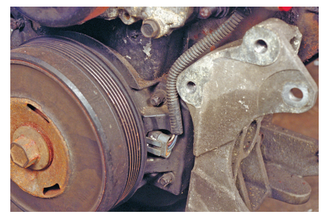
Sensors
A voltage pulse from a crankshaft position sensor activates the transistor in the control module.
In most ignition systems, this sensor is either a magnetic pulse generator or Hall-effect sensor.
These sensors are mounted either on the distributor shaft, crankshaft, or flywheel.
Under unusual circumstances, the nonmagnetic reluctor can become magnetized and upset the pickup coil’s voltage signal to the control module.
Use a steel feeler gauge to check for signs of magnetic attraction and replace the reluctor if the test is positive.

Slide 11
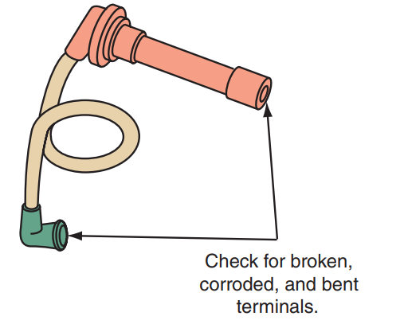
Secondary Circuit
Spark plug (ignition) and coil cables should be pushed tightly into the distributor cap and coil and onto spark plugs.
Inspect all secondary cables for cracks and worn insulation, which cause high-voltage leaks.
Inspect all of the boots on the ends of the secondary wires for cracks and hard, brittle conditions.
Replace the wires and boots if they show evidence of these conditions.
Inspect the terminals inside of the boots.
Often corrosion and signs of arcing are found inside the boots.

Slide 12
Knowledge Check (1 of 2)
Are spark plugs part of the primary or secondary circuit?

Slide 13
Knowledge Check Answer (1 of 2)
  Answer: They are part of the secondary circuit which is high voltage.

Slide 14
No-Start Diagnosis of EI Systems
27.03 Perform a no-start diagnosis and determine the cause of the condition.
When an engine with an EI system has a no-start problem, begin diagnosis by connecting a scan tool.
Check for DTCs and make sure the PCM shows rpm when cranking the engine.
Without an rpm reference, the PCM cannot trigger the ignition coils or fuel injectors.
There are many ignition-related DTCs that may be set by the PCM when there is a no-start condition.
Always retrieve the codes and follow their pinpoint tests when diagnosing an EI system. A stored P0335 indicates a problem with the CKP circuit, which can cause a no-start condition.
Follow the manufacturer’s diagnostic information to determine the cause of the fault.
If the PCM set no codes, follow this procedure to identify the cause of a no-start problem.

Slide 15
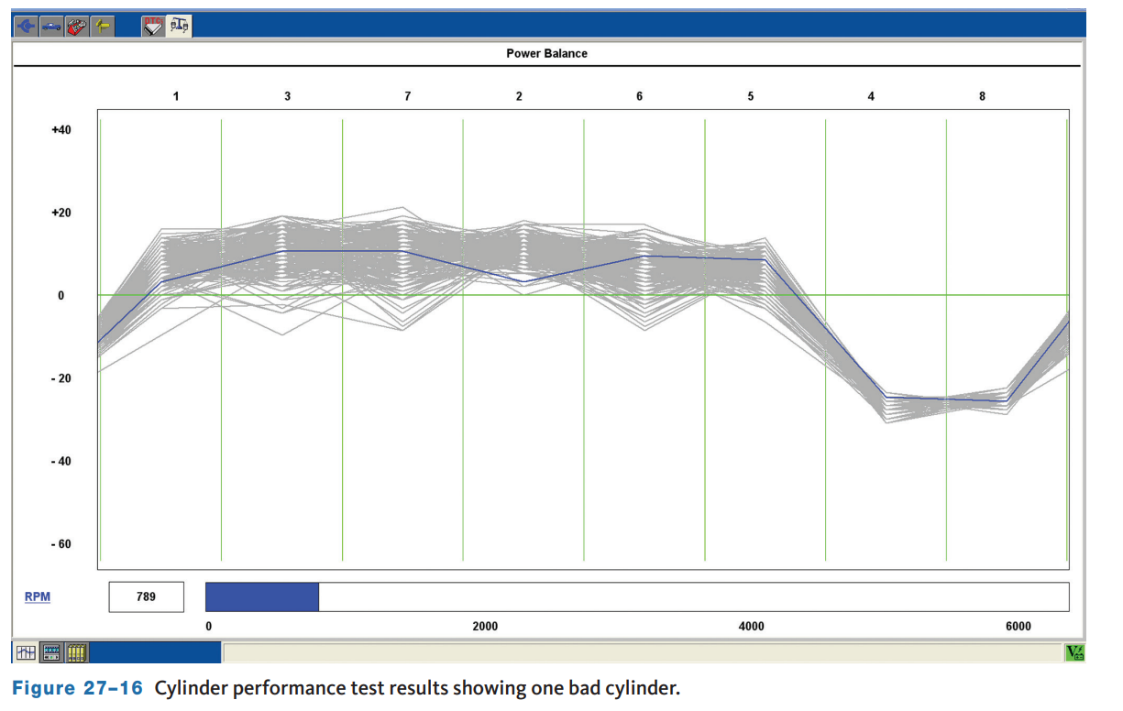
Diagnosing Ignition Systems (1 of 3)
Cylinder Performance Test
  During the cylinder performance test (also called the power balance or contribution test), engine rpm is monitored while either the ignition or fuel injection is stopped for each cylinder one at a time.
  During this brief time, the rpm drop is recorded.
  When a cylinder is not contributing to engine power due to low compression or some other problem, there will be very little rpm drop when that cylinder stops firing.
  If a cylinder was misfiring prior to the test, the cylinder will have high HC emissions.

Slide 16
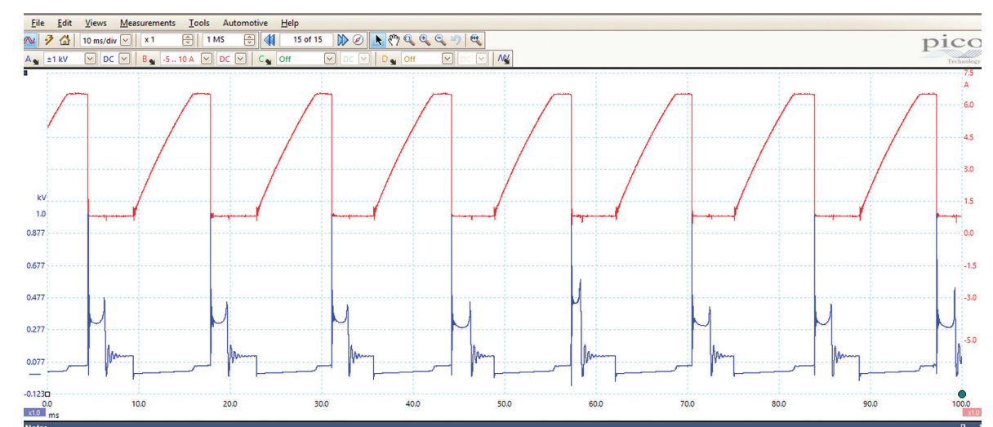
Diagnosing Ignition Systems (2 of 3)
27.05 Diagnose ignition system concerns using a lab scope.
Scope Patterns
  An oscilloscope or “scope” converts the electrical activity of the ignition system into a visual image showing voltage changes over a given period.
  This information is displayed on a screen in the form of a continuous voltage line called a pattern or trace.
  By studying the pattern, a technician can see what the ignition system is doing.
  Connecting the scope to a DIS system requires adapters or additional test leads.
  The leads are connected to the individual spark plug wires.

Slide 17
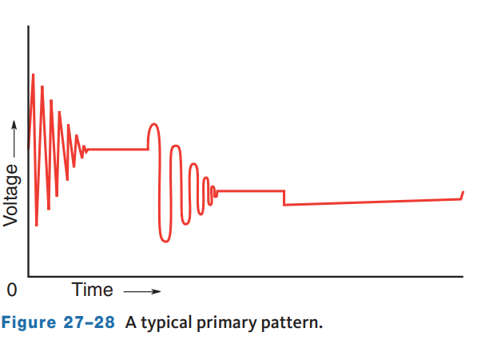
Diagnosing Ignition Systems (3 of 3)
Primary Circuit Checks
  The primary ignition pattern shows the action of the primary circuit.
  To be able to spot abnormal sections of a primary waveform, you must know what causes each change of voltage and time in a normal primary waveform.
  Although the true cycle of the primary circuit begins and ends when the switching transistor is turned on, the displayed pattern begins right after the transistor is turned off.

Slide 18
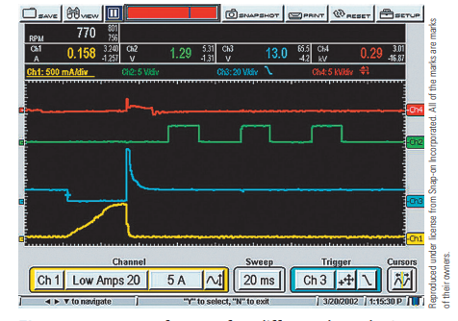
Diagnosing with a DSO or GMM
The graphing meter function is much like using a scope, except that it also displays digital MIN/MAX readings with the trace.
Many have a four-channel capability, which means you can look at the signals from four different sensors and/or outputs at the same time.
This mode also allows a technician to observe any glitches or noise that may affect operation.
In most cases, additional leads must be attached to the lab scope or GMM to read additional channels.
These are color-coded and the color of the display matches the color of the lead.

Slide 19
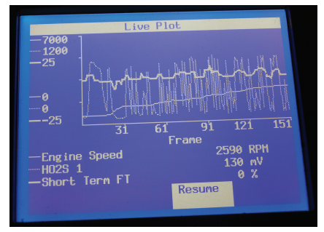
Ignition Timing
Most primary circuit problems in a computer-controlled ignition system result in starting problems or poor performance due to incorrect timing.
If engine performance is poor, the cause of the problem can be many things.
When the ignition timing is not correct, many tests will point to the problem.
Incorrect ignition timing will cause incomplete combustion at one or all engine speeds.
Incomplete combustion will cause excessive O₂ in the exhaust.
This will cause the PCM to try to correct the apparent lean mixture.

Slide 20
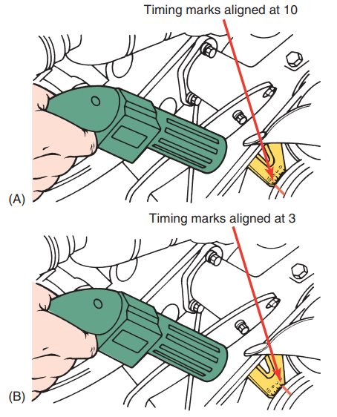
Setting Ignition Timing
To check the ignition timing, a timing light is aimed at the ignition timing marks.
The timing marks are usually located on the crankshaft pulley or the flywheel.
A stationary pointer, line, or notch is positioned above the rotating timing marks. The timing marks are lines on the crankshaft pulley or flywheel that represent various positions of the piston as it relates to TDC.
When piston 1 is at TDC, the timing line or notch will line up with the zero reference mark on the timing plate.
Usually, an engine is timed so that the number 1 spark plug fires several degrees BTDC.

Slide 21
Discussion
Setting ignition timing like previously described is a rare task in a typical shop today. However, in the past, this was a commonly required service.
Have a class discussion about the steps that are taken in detail to gain better understanding of the process.

Slide 22
Diagnosing Primary Circuit Components
27.08 Test the components of the primary and secondary ignition circuits.
The primary circuit has the responsibility of controlling the action of the secondary and, in many cases, is the cause of starting problems.
The components in the primary ignition circuit vary with manufacturer and design.
It is important to identify the component of the circuit and the appropriate test methods.
Always work systematically through a circuit, testing each wire, connector, and component.
Do not jump from one component to another.
Always compare the readings with specifications given by the manufacturer.

Slide 23
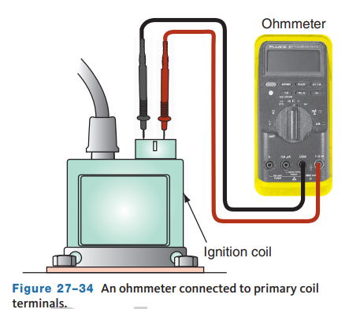
Ignition Coil Resistance
To check the primary windings, set the ohmmeter to the auto-range mode and connect the meter across to the primary coil (BAT and TACH or + and −) terminals.
Coil primary resistance is typically low, a couple of ohms or less.
An infinite ohmmeter reading indicates an open winding.
Higher-than-normal readings indicate the presence of excessive resistance.
If the measurement is less than the specified resistance, the windings are shorted.
To check the secondary winding, connect the meter between the coil’s secondary terminal and the positive (BAT) terminal of the coil.

Slide 24
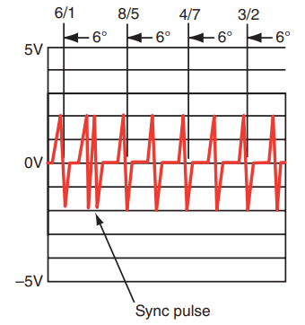
Crankshaft/Camshaft Sensors
Although ignition timing on most EI systems is not adjustable, the air gaps at the crankshaft and camshaft sensors will affect the operation of the ignition system.
On some engines, this gap is adjustable, and on others, it is an indication that the sensor should be replaced.
Measure the gap with a nonmagnetic feeler gauge. Compare your findings to specifications. If the gap is not correct, the sensor should be replaced or the gap adjusted.
Also, the action of the sensors can be monitored with an AC voltmeter or a lab scope connected across the sensor terminals to check the sensor signal while the engine is cranking.

Slide 25
Pickup Coils
To test magnetic pulse and metal detection pickup coils inside a distributor or used as a CKP or CMP with an ohmmeter, connect the ohmmeter from one of the pickup leads to ground to test for a short to ground.
If there is a short to ground, the ohmmeter will have a reading of less than specifications.
Most pickup coils have 150 to 900 ohms resistance, but always refer to the manufacturer’s specifications.
If the pickup coil is open, the ohmmeter will display an infinite reading.
When the pickup coil is shorted, the ohmmeter will display a reading lower than specifications.
While the ohmmeter leads are connected, pull on the pickup leads and watch for an erratic reading, indicating an intermittent open in the pickup leads.
The gap should be measured with a nonmagnetic feeler gauge placed between the reluctor high points and the pickup coil.

Slide 26
Hall-Effect Sensors
With the voltmeter hooked up, insert a steel feeler gauge or knife blade between the Hall layer and magnet.
If the sensor is good, the voltmeter should read within 0.5 volt of battery voltage when the feeler gauge or knife blade is inserted and touching the magnet.
When the feeler gauge or blade is removed, the voltage should read less than 0.5 volt. In the following tests, the distributor connector is connected to the unit and the connector backprobed.
With the ignition switch on, a voltmeter should be connected from the voltage input wire to ground.
The ground wire should be tested with the ignition switch on and a voltmeter connected from the ground wire to a ground connection near the distributor.
With this meter connection, the meter indicates the voltage drop across the ground wire, which should not exceed 0.2 volt.
Connect a digital voltmeter from the pickup signal wire to ground.
If the voltmeter reading does not fluctuate while cranking the engine, the pickup is defective.

Slide 27
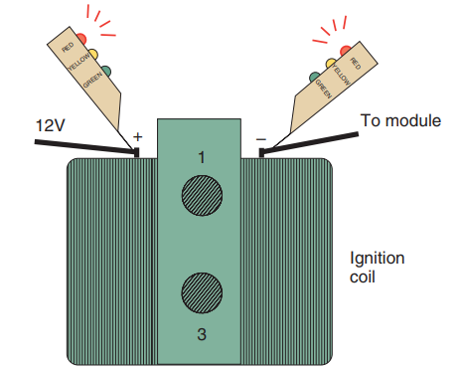
Using a Logic Probe
The primary can also be checked with a logic probe.
There are three lights on a logic probe.
  Yellow, red, and green.
To check the primary circuit with a logic probe, turn the ignition on.
Touch the probe to both (positive and negative) primary terminals at the coil.
The red light should come on at both terminals, indicating that at least 10 volts are available to the coil and that there is continuity through the coil.
If the red light does not come on when the positive side of the coil is probed, check the power feed circuit to the coil.

Slide 28
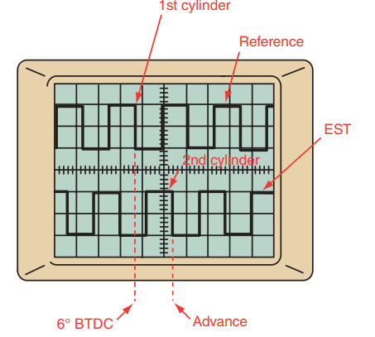
Using a Lab Scope
If the crankshaft sensor is a Hall-effect switch, square waves should be seen on the scope.
All pulses should normally be identical in spacing, shape, and amplitude.
Note that some systems use a different size shutter to designate cylinder 1.
This will cause the waveform to display one square wave that is different than the others.
By using a dual-trace lab scope, the relationship between the crankshaft sensor and the ignition module can be observed.
During starting, the module will provide a fixed amount of timing advance according to its program and the cranking speed of the engine.

Slide 29
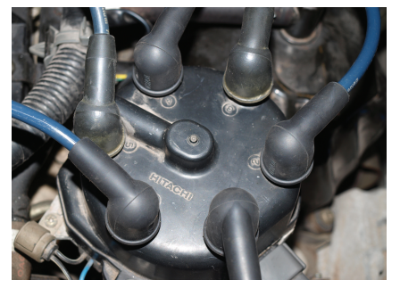
Secondary Circuit Tests and Service
27.06 Test individual ignition components using test equipment such as a voltmeter, ohmmeter, and test light.
Distributor Cap and Rotor
  When installing a new cap or rotor, it is always wise to replace both at the same time.
  Make sure both are fully seated before attempting to start the engine.
  Also remember that the spark plug wires need to be arranged on the cap according to the firing order.

Slide 30
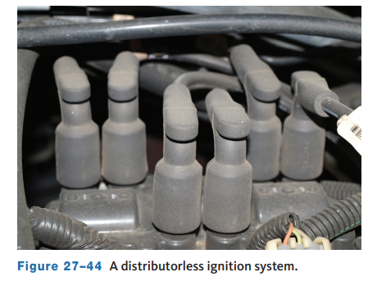
Waste Spark Systems
Standard test procedures using an oscilloscope and a DMM can be used to diagnose problems in distributorless ignition systems.
Keep in mind, however, that problems involving one cylinder may also occur in its companion cylinder that fires off the same coil.
Follow the testing procedures given in the service information.
Specific DTCs are designed to help troubleshoot ignition problems in these systems.
The diagnostic procedure for EI systems varies depending on the vehicle make and model year.

Slide 31
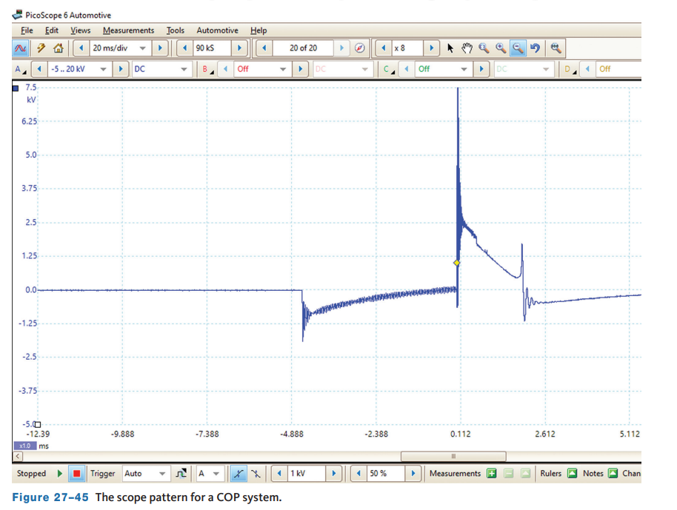
Coil-over-Plug Systems
Ignition coils are tested with an ohmmeter in much the same way as other ignition coils.
If the resistance is out of specifications, the coil should be replaced.
Intermittent coil problems can be caused by corrosion at the electrical connectors to the coil.
The action of the secondary can also be monitored on a lab scope.
Codes retrieved from the PCM will indicate whether the misfire is a general one or an individual cylinder.
Because a COP ignition problem will affect only one cylinder, the general misfire code (P0300) is probably caused by a fuel delivery problem or a vacuum leak.

Slide 32
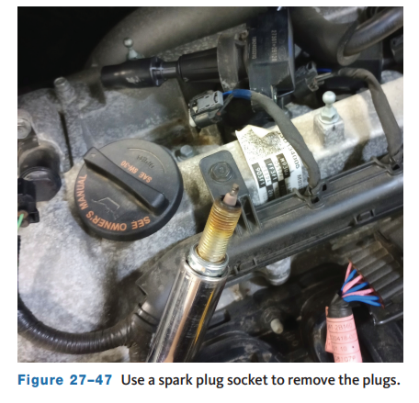
Spark Plugs
The recommended replacement interval depends on a number of factors but ranges from 20,000 to 100,000 miles (32,000 to 160,000 km).
Using a spark plug socket and ratchet, loosen each plug a couple of turns.
A spark plug socket should be used because it has an internal rubber bushing to prevent plug insulator breakage.
Spark plug sockets can have either a 3 /8- or ½-inch drive, and most have an external hex so that they can be turned using an open-end or box wrench.
Once the plugs are loose, use compressed air to blow dirt away from the base of the plugs.

Slide 33
Knowledge Check (2 of 2)
What is the replacement interval for spark plugs?

Slide 34
Knowledge Check Answer (2 of 2)
It varies drastically from vehicle to vehicle.
The recommended replacement interval depends on a number of factors but ranges from 20,000 to 100,000 miles (32,000 to 160,000 km).

Slide 35
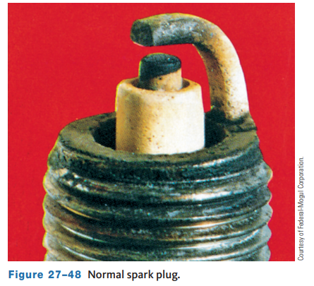
Inspecting Spark Plugs
27.09 Service and install spark plugs.
Once the spark plugs have been removed, it is important to inspect them closely, noting in particular any deposits on the plugs and the degree of electrode erosion.
A normal-firing spark plug will have a minimum amount of deposits on it and will be colored light tan or gray.
There should be no evidence of electrode burning, and the increase of the air gap should be no more than 0.001 inch (0.0254 mm) for every 10,000 miles (16,000 km) of engine operation.
A plug that exceeds this wear should be replaced and the cause of excessive wear corrected.

Slide 36
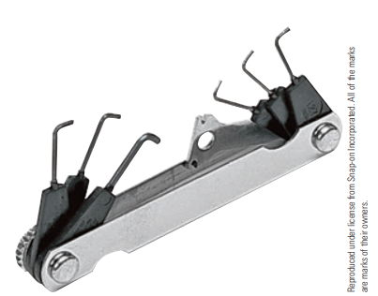
Regapping Spark Plugs
Both new and used spark plugs should have their air gaps set to manufacturer’s specifications.
Always use round wire gauges when check.
After the gap has been adjusted, make sure that the ground electrode is as horizontal as it can be.
Always check the air gap of a new spark plug before installing it.
Never assume the gap is correct just because the plug is new.
Do not try to reduce a plug’s air gap by tapping the side electrode on a bench.
Use a spark plug gapping tool to bend the ground electrode to its correct height.

Slide 37
Secondary Ignition Wires
Inspect all the spark plug wires and the secondary coil wire for cracks and worn insulation, which cause high-voltage leaks.
Inspect all the boots on the ends of the plug wires and coil secondary wire for cracks and hard, brittle conditions.
Make sure that the secondary cables are secured tightly to the spark plugs and the ignition coil(s).
Also check the cables for any damage or signs of arcing.
Replace the wires and boots if they show evidence of these conditions.
Most manufacturers recommend that spark plug wires be replaced as a complete set.

Slide 38
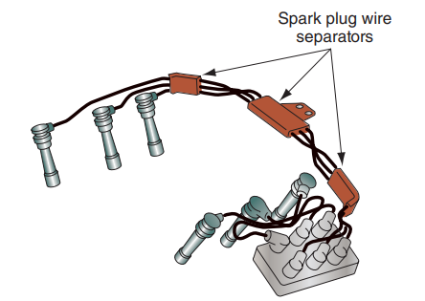
Replacing Spark Plug Wires
When spark plug wires are being installed, make sure they are routed properly as indicated in the vehicle’s service information.
When removing the spark plug wires from a spark plug, grasp the spark plug boot tightly, and twist while pulling the cable from the end of the plug.
When installing a spark plug wire, make sure the boot is firmly seated around the top of the plug, and then squeeze the boot to expel any air that may be trapped inside.
Also make sure that the wires are secure in their looms and that the looms are properly placed.

Slide 39
Chapter Reflection
Please take a moment to compare your understanding of ignition systems diagnosis and service. Then respond to the following questions in one or two paragraphs. Use 150–200 words in your reflection.
Was there anything in this chapter you felt you struggled to understand? What will you do to improve your level of understanding?
Considering all you have learned, do you feel you are prepared to perform ignition system service in a shop or lab setting? What will you do to ensure you are prepared?

